Slide 1
CS162 Operating Systems and Systems Programming Lecture 4 Introduction to I/O, Sockets, Networking
September 9th, 2015
Prof. John Kubiatowicz
http://cs162.eecs.Berkeley.edu

Slide 2
Recall: Fork and Wait
…
cpid = fork();
if (cpid > 0) { /* Parent Process */
mypid = getpid();
printf("[%d] parent of [%d]\n", mypid, cpid);
tcpid = wait(&status);
printf("[%d] bye %d\n", mypid, tcpid);
} else if (cpid == 0) { /* Child Process */
mypid = getpid();
printf("[%d] child\n", mypid);
}
…
Return value from Fork: integer
When > 0: return value is pid of new child (Running in Parent)
When = 0: Running in new Child process
When < 0: Error! Must handle somehow
Wait() system call: wait for next child to exit
Return value is PID of terminating child
Argument is pointer to integer variable to hold exit status

Slide 3
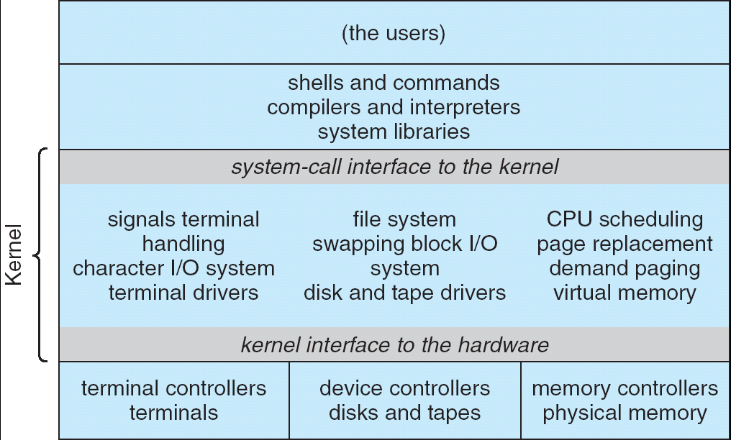
Recall: UNIX System Structure
Applications
User Mode
Standard Libs
Kernel Mode
Hardware

Slide 4
How does the kernel provide services?
You said that applications request services from the operating system via syscall, but …
I’ve been writing all sort of useful applications and I never ever saw a “syscall” !!!
That’s right.
It was buried in the programming language runtime library (e.g., libc.a)
… Layering

Slide 5
OS run-time library
Proc 1
Proc 2
Proc n
…
OS
Appln
login
Window Manager
…
OS library
OS library
OS library
OS

Slide 6
A Kind of Narrow Waist
Word Processing
Compilers
Web Browsers
Email
Databases
Web Servers
Application / Service
Portable OS Library
OS
User
System Call
Interface
System
Portable OS Kernel
Software
Platform support, Device Drivers
Hardware
x86
PowerPC
ARM
PCI
Ethernet (10/100/1000)
802.11 a/b/g/n
SCSI
IDE
Graphics

Slide 7
Key Unix I/O Design Concepts
Uniformity
file operations, device I/O, and interprocess communication through open, read/write, close
Allows simple composition of programs
find | grep | wc …
Open before use
Provides opportunity for access control and arbitration
Sets up the underlying machinery, i.e., data structures
Byte-oriented
Even if blocks are transferred, addressing is in bytes
Kernel buffered reads
Streaming and block devices looks the same
read blocks process, yielding processor to other task
Kernel buffered writes
Completion of out-going transfer decoupled from the application, allowing it to continue
Explicit close

Slide 8
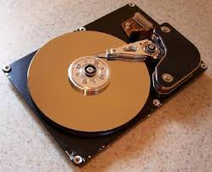
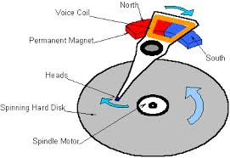
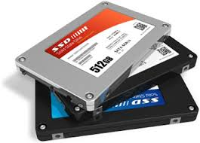

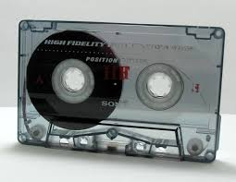
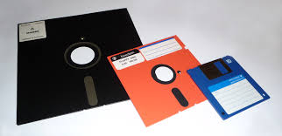
I/O & Storage Layers
Application / Service
streams
High Level I/O
Low Level I/O
handles
Syscall
registers
File System
descriptors
I/O Driver
Commands and Data Transfers
Disks, Flash, Controllers, DMA

Slide 9
The file system abstraction
High-level idea
Files live in hierarchical namespace of filenames
File
Named collection of data in a file system
File data
Text, binary, linearized objects
File Metadata: information about the file
Size, Modification Time, Owner, Security info
Basis for access control
Directory
“Folder” containing files & Directories
Hierachical (graphical) naming
Path through the directory graph
Uniquely identifies a file or directory
/home/ff/cs162/public_html/fa14/index.html
Links and Volumes (later)

Slide 10
C high level File API – streams (review)
Operate on “streams” - sequence of bytes, whether text or data, with a position
#include <stdio.h>
FILE *fopen( const char *filename, const char *mode );
int fclose( FILE *fp );
Mode Text | Binary | Descriptions
r | rb | Open existing file for reading
w | wb | Open for writing; created if does not exist
a | ab | Open for appending; created if does not exist
r+ | rb+ | Open existing file for reading & writing.
w+ | wb+ | Open for reading & writing; truncated to zero if exists, create otherwise
a+ | ab+ | Open for reading & writing. Created if does not exist. Read from beginning, write as append
Don’t forget to flush

Slide 11
Connecting Processes, Filesystem, and Users
Process has a ‘current working directory’
Absolute Paths
/home/ff/cs152
Relative paths
index.html, ./index.html - current WD
../index.html - parent of current WD
~, ~cs152 - home directory

Slide 12
C API Standard Streams
Three predefined streams are opened implicitly when the program is executed.
FILE *stdin – normal source of input, can be redirected
FILE *stdout – normal source of output, can be redirected
FILE *stderr – diagnostics and errors, can be redirected
STDIN / STDOUT enable composition in Unix
Recall: Use of pipe symbols connects STDOUT and STDIN
find | grep | wc …

Slide 13
C high level File API – stream ops
#include <stdio.h>
// character oriented
int fputc( int c, FILE *fp ); // rtn c or EOF on err
int fputs( const char *s, FILE *fp ); // rtn >0 or EOF
int fgetc( FILE * fp );
char *fgets( char *buf, int n, FILE *fp );
// block oriented
size_t fread(void *ptr, size_t size_of_elements,
size_t number_of_elements, FILE *a_file);
size_t fwrite(const void *ptr, size_t size_of_elements,
size_t number_of_elements, FILE *a_file);
// formatted
int fprintf(FILE *restrict stream, const char *restrict format, ...);
int fscanf(FILE *restrict stream, const char *restrict format, ...);

Slide 14
Example code
#include <stdio.h>
#define BUFLEN 256
FILE *outfile;
char mybuf[BUFLEN];
int storetofile() {
char *instring;
outfile = fopen(“/usr/homes/testing/tokens”,”w+”);
if (!outfile)
return (-1); // Error!
while (1) {
instring = fgets(*mybuf, BUFLEN, stdin); // catches overrun!
// Check for error or end of file (^D)
if (!instring || strlen(instring)==0) break;
// Write string to output file, exit on error
if (fputs(instring, outfile)< 0) break;
}
fclose(outfile); // Flushes from userspace
}

Slide 15
C Stream API positioning
int fseek(FILE *stream, long int offset, int whence); long int ftell (FILE *stream)
void rewind (FILE *stream)
Preserves high level abstraction of uniform stream of objects
Adds buffering for performance

Slide 16
Administrivia: Getting started
Final class enrollment: ~321
Waitlist was emptied
Homework 1 Due Monday, 9/21
Get moving on it!
Participation: Get to know your TA!
We have some seriously under-subscribed sections – consider going to one of them!
Under subscribed:
Friday 1-2, 87 Evans
Friday 2-3, 6 Evans
Friday 11-12, B51 Hildebrand
OverSubscribed:
Friday 10-11, 385 LeConte
Group sign up form out this week
Get finding groups ASAP
4 people in a group! Same TA! (better – same section)

Slide 17
Administrivia (Con’t)
Kubiatowicz Office Hours (really!)
1pm-2pm, Monday/Wednesday
Midterm 2 conflict: See Piazza poll!
Monday 2/23: 7-10 pm? Slightly hard on DataScience folks, but all done in one day! (Drown sorrows in turkey?).
Wednesday 11/18: Conflict with EE16A – evening

Slide 18
What’s below the surface ??
Application / Service
High Level I/O
streams
Low Level I/O
handles
Syscall
registers
File System
descriptors
I/O Driver
Commands and Data Transfers
Disks, Flash, Controllers, DMA

Slide 19
C Low level I/O
Operations on File Descriptors – as OS object representing the state of a file
User has a “handle” on the descriptor
#include <fcntl.h>
#include <unistd.h>
#include <sys/types.h>
int open (const char *filename, int flags [, mode_t mode])
int creat (const char *filename, mode_t mode)
int close (int filedes)
Bit vector of:
Access modes (Rd, Wr, …)
Open Flags (Create, …)
Operating modes (Appends, …)
Bit vector of Permission Bits:
User|Group|Other X R|W|X
http://www.gnu.org/software/libc/manual/html_node/Opening-and-Closing-Files.html

Slide 20
C Low Level: standard descriptors
#include <unistd.h>
STDIN_FILENO - macro has value 0
STDOUT_FILENO - macro has value 1
STDERR_FILENO - macro has value 2
int fileno (FILE *stream)
FILE * fdopen (int filedes, const char *opentype)
Crossing levels: File descriptors vs. streams
Don’t mix them!

Slide 21
C Low Level Operations
ssize_t read (int filedes, void *buffer, size_t maxsize)
- returns bytes read, 0 => EOF, -1 => error
ssize_t write (int filedes, const void *buffer, size_t size)
- returns bytes written
off_t lseek (int filedes, off_t offset, int whence)
int fsync (int fildes) – wait for i/o to finish
void sync (void) – wait for ALL to finish
When write returns, data is on its way to disk and can be read, but it may not actually be permanent!

Slide 22
And lots more !
TTYs versus files
Memory mapped files
File Locking
Asynchronous I/O
Generic I/O Control Operations
Duplicating descriptors
int dup2 (int old, int new)
int dup (int old)

Slide 23
Another example: lowio-std.c
#include <stdlib.h>
#include <stdio.h>
#include <string.h>
#include <unistd.h>
#include <sys/types.h>
#define BUFSIZE 1024
int main(int argc, char *argv[])
{
char buf[BUFSIZE];
ssize_t writelen = write(STDOUT_FILENO, "I am a process.\n", 16);
ssize_t readlen = read(STDIN_FILENO, buf, BUFSIZE);
ssize_t strlen = snprintf(buf, BUFSIZE,"Got %zd chars\n", readlen);
writelen = strlen < BUFSIZE ? strlen : BUFSIZE;
write(STDOUT_FILENO, buf, writelen);
exit(0);
}

Slide 24
What’s below the surface ??
Application / Service
High Level I/O
streams
Low Level I/O
handles
Syscall
registers
File System
descriptors
I/O Driver
Commands and Data Transfers
Disks, Flash, Controllers, DMA

Slide 25
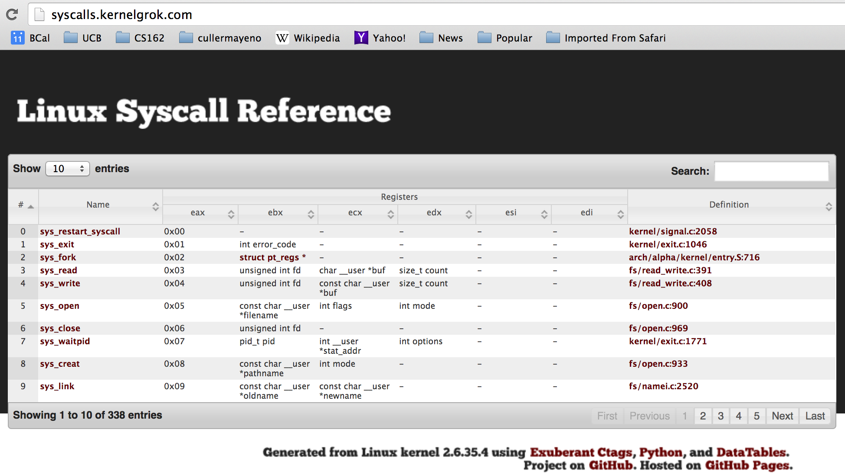
Recall: SYSCALL
Low level lib parameters are set up in registers and syscall instruction is issued
A type of synchronous exception that enters well-defined entry points into kernel

Slide 26
What’s below the surface ??
File descriptor number
- an int
Application / Service
streams
High Level I/O
Low Level I/O
handles
Syscall
registers
File System
descriptors
File Descriptors
- a struct with all the info about the files
I/O Driver
Commands and Data Transfers
Disks, Flash, Controllers, DMA

Slide 27
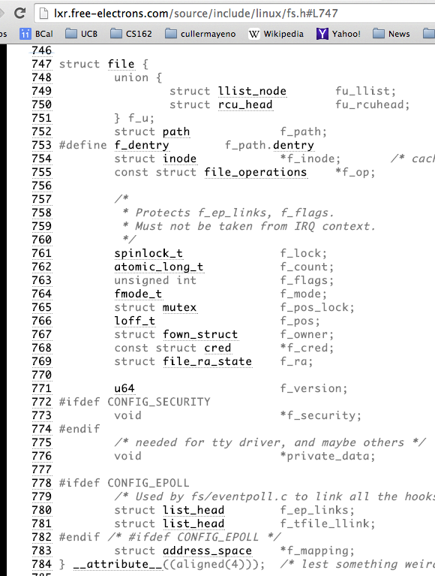
Internal OS File Descriptor
Internal Data Structure describing everything about the file
Where it resides
Its status
How to access it
Pointer to

Slide 28
File System: from syscall to driver
In fs/read_write.c
ssize_t vfs_read(struct file *file, char __user *buf, size_t count, loff_t *pos)
{
ssize_t ret;
if (!(file->f_mode & FMODE_READ)) return -EBADF;
if (!file->f_op || (!file->f_op->read && !file->f_op->aio_read))
return -EINVAL;
if (unlikely(!access_ok(VERIFY_WRITE, buf, count))) return -EFAULT;
ret = rw_verify_area(READ, file, pos, count);
if (ret >= 0) {
count = ret;
if (file->f_op->read)
ret = file->f_op->read(file, buf, count, pos);
else
ret = do_sync_read(file, buf, count, pos);
if (ret > 0) {
fsnotify_access(file->f_path.dentry);
add_rchar(current, ret);
}
inc_syscr(current);
}
return ret;
}

Slide 29
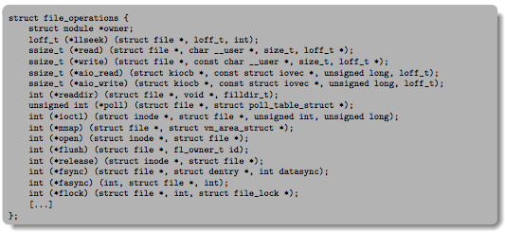
Lower Level Driver
Associated with particular hardware device
Registers / Unregisters itself with the kernel
Handler functions for each of the file operations

Slide 30
Recall: Device Drivers
Device Driver: Device-specific code in the kernel that interacts directly with the device hardware
Supports a standard, internal interface
Same kernel I/O system can interact easily with different device drivers
Special device-specific configuration supported with the ioctl() system call
Device Drivers typically divided into two pieces:
Top half: accessed in call path from system calls
implements a set of standard, cross-device calls like open(), close(), read(), write(), ioctl(), strategy()
This is the kernel’s interface to the device driver
Top half will start I/O to device, may put thread to sleep until finished
Bottom half: run as interrupt routine
Gets input or transfers next block of output
May wake sleeping threads if I/O now complete

Slide 31
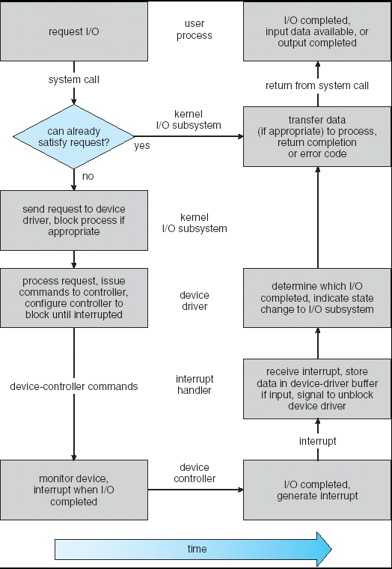
Life Cycle of An I/O Request
User
Program
Kernel I/O
Subsystem
Device Driver
Top Half
Device Driver
Bottom Half
Device
Hardware

Slide 32
So what happens when you fgetc?
Application / Service
High Level I/O
streams
Low Level I/O
handles
Syscall
registers
File System
descriptors
I/O Driver
Commands and Data Transfers
Disks, Flash, Controllers, DMA

Slide 33
Communication between processes
Can we view files as communication channels?
Producer and Consumer of a file may be distinct processes
May be separated in time (or not)
However, what if data written once and consumed once?
Don’t we want something more like a queue?
Can still look like File I/O!
write(wfd, wbuf, wlen);
n = read(rfd,rbuf,rmax);

Slide 34
Communication Across the world looks like file IO
write(wfd, wbuf, wlen);
n = read(rfd,rbuf,rmax);
Connected queues over the Internet
But what’s the analog of open?
What is the namespace?
How are they connected in time?

Slide 35
Request Response Protocol
Client (issues requests)
Server (performs operations)
write(rqfd, rqbuf, buflen);
requests
n = read(rfd,rbuf,rmax);
wait
service request
write(wfd, respbuf, len);
responses
n = read(resfd,resbuf,resmax);

Slide 36
Request Response Protocol
Client (issues requests)
Server (performs operations)
write(rqfd, rqbuf, buflen);
requests
n = read(rfd,rbuf,rmax);
wait
service request
write(wfd, respbuf, len);
responses
n = read(resfd,resbuf,resmax);

Slide 37
Client-Server Models
Client 1
Client 2
Server
***
Client n
File servers, web, FTP, Databases, …
Many clients accessing a common server

Slide 38
Sockets
Socket: an abstraction of a network I/O queue
Mechanism for inter-process communication
Embodies one side of a communication channel
Same interface regardless of location of other end
Could be local machine (called “UNIX socket”) or remote machine (called “network socket”)
First introduced in 4.2 BSD UNIX: big innovation at time
Now most operating systems provide some notion of socket
Data transfer like files
Read / Write against a descriptor
Over ANY kind of network
Local to a machine
Over the internet (TCP/IP, UDP/IP)
OSI, Appletalk, SNA, IPX, SIP, NS, …

Slide 39


Silly Echo Server – running example
Client (issues requests)
Server (performs operations)
gets(fd,sndbuf, …);
requests
write(fd, buf,len);
n = read(fd,buf,);
wait
print
write(fd, buf,);
responses
n = read(fd,rcvbuf, );
print

Slide 40
Echo client-server example
void client(int sockfd) {
int n;
char sndbuf[MAXIN]; char rcvbuf[MAXOUT];
getreq(sndbuf, MAXIN); /* prompt */
while (strlen(sndbuf) > 0) {
write(sockfd, sndbuf, strlen(sndbuf)); /* send */
memset(rcvbuf,0,MAXOUT); /* clear */
n=read(sockfd, rcvbuf, MAXOUT-1); /* receive */
write(STDOUT_FILENO, rcvbuf, n); /* echo */
getreq(sndbuf, MAXIN); /* prompt */
}
}
void server(int consockfd) {
char reqbuf[MAXREQ];
int n;
while (1) {
memset(reqbuf,0, MAXREQ);
n = read(consockfd,reqbuf,MAXREQ-1); /* Recv */
if (n <= 0) return;
n = write(STDOUT_FILENO, reqbuf, strlen(reqbuf));
n = write(consockfd, reqbuf, strlen(reqbuf)); /* echo*/
}
}

Slide 41
Prompt for input
char *getreq(char *inbuf, int len) {
/* Get request char stream */
printf("REQ: "); /* prompt */
memset(inbuf,0,len); /* clear for good measure */
return fgets(inbuf,len,stdin); /* read up to a EOL */
}

Slide 42
Socket creation and connection
File systems provide a collection of permanent objects in structured name space
Processes open, read/write/close them
Files exist independent of the processes
Sockets provide a means for processes to communicate (transfer data) to other processes.
Creation and connection is more complex
Form 2-way pipes between processes
Possibly worlds away

Slide 43
Namespaces for communication over IP
Hostname
www.eecs.berkeley.edu
IP address
128.32.244.172 (ipv6?)
Port Number
0-1023 are “well known” or “system” ports
Superuser privileges to bind to one
1024 – 49151 are “registered” ports (registry)
Assigned by IANA for specific services
49152–65535 (2¹⁵+2¹⁴ to 2¹⁶−1) are “dynamic” or “private”
Automatically allocated as “ephemeral Ports”

Slide 44
Socket Setup over TCP/IP
Server
Socket
Request Connection
new
socket
socket
socket
connection
Client
Server
Server Socket: Listens for new connections
Produces new sockets for each unique connection
Things to remember:
Connection involves 5 values: [ Client Addr, Client Port, Server Addr, Server Port, Protocol ]
Often, Client Port “randomly” assigned
Done by OS during client socket setup
Server Port often “well known”
80 (web), 443 (secure web), 25 (sendmail), etc
Well-known ports from 0—1023

Slide 45
Sockets in concept
Client
Server
Create Server Socket
Bind it to an Address
(host:port)
Create Client Socket
Connect it to server (host:port)
Listen for Connection
Connection Socket
Accept connection
Connection Socket
write request
read request
read response
write response
Close Client Socket
Close Connection Socket
Close Server Socket

Slide 46
Client Protocol
char *hostname;
int sockfd, portno;
struct sockaddr_in serv_addr;
struct hostent *server;
server = buildServerAddr(&serv_addr, hostname, portno);
/* Create a TCP socket */
sockfd = socket(AF_INET, SOCK_STREAM, 0)
/* Connect to server on port */
connect(sockfd, (struct sockaddr *) &serv_addr, sizeof(serv_addr)
printf("Connected to %s:%d\n",server->h_name, portno);
/* Carry out Client-Server protocol */
client(sockfd);
/* Clean up on termination */
close(sockfd);

Slide 47
Server Protocol (v1)
/* Create Socket to receive requests*/
lstnsockfd = socket(AF_INET, SOCK_STREAM, 0);
/* Bind socket to port */
bind(lstnsockfd, (struct sockaddr *)&serv_addr,sizeof(serv_addr));
while (1) {
/* Listen for incoming connections */
listen(lstnsockfd, MAXQUEUE);
/* Accept incoming connection, obtaining a new socket for it */
consockfd = accept(lstnsockfd, (struct sockaddr *) &cli_addr,
&clilen);
server(consockfd);
close(consockfd);
}
close(lstnsockfd);

Slide 48
How does the server protect itself?
Isolate the handling of each connection
By forking it off as another process

Slide 49
Sockets With Protection
Client
Server
Create Server Socket
Bind it to an Address
(host:port)
Create Client Socket
Connect it to server (host:port)
Listen for Connection
Accept connection
child
Connection Socket
Parent
Close Listen Socket
Close Connection Socket
write request
read request
read response
write response
Close Connection Socket
Wait for child
Close Client Socket
Close Server Socket

Slide 50
Server Protocol (v2)
while (1) {
listen(lstnsockfd, MAXQUEUE);
consockfd = accept(lstnsockfd, (struct sockaddr *) &cli_addr,
&clilen);
cpid = fork(); /* new process for connection */
if (cpid > 0) { /* parent process */
close(consockfd);
tcpid = wait(&cstatus);
} else if (cpid == 0) { /* child process */
close(lstnsockfd); /* let go of listen socket */
server(consockfd);
close(consockfd);
exit(EXIT_SUCCESS); /* exit child normally */
}
}
close(lstnsockfd);

Slide 51
Concurrent Server
Listen will queue requests
Buffering present elsewhere
But server waits for each connection to terminate before initiating the next

Slide 52
Sockets With Protection and Parallelism
Client
Server
Create Server Socket
Bind it to an Address
(host:port)
Create Client Socket
Connect it to server (host:port)
Listen for Connection
Accept connection
child
Connection Socket
Parent
Close Listen Socket
Close Connection Socket
write request
read request
read response
write response
Close Connection Socket
Close Client Socket
Close Server Socket

Slide 53
Server Protocol (v3)
while (1) {
listen(lstnsockfd, MAXQUEUE);
consockfd = accept(lstnsockfd, (struct sockaddr *) &cli_addr,
&clilen);
cpid = fork(); /* new process for connection */
if (cpid > 0) { /* parent process */
close(consockfd);
//tcpid = wait(&cstatus);
} else if (cpid == 0) { /* child process */
close(lstnsockfd); /* let go of listen socket */
server(consockfd);
close(consockfd);
exit(EXIT_SUCCESS); /* exit child normally */
}
}
close(lstnsockfd);

Slide 54
Server Address - itself
memset((char *) &serv_addr,0, sizeof(serv_addr));
serv_addr.sin_family = AF_INET;
serv_addr.sin_addr.s_addr = INADDR_ANY;
serv_addr.sin_port = htons(portno);
Simple form
Internet Protocol
accepting any connections on the specified port
In “network byte ordering”

Slide 55
Client: getting the server address
struct hostent *buildServerAddr(struct sockaddr_in *serv_addr,
char *hostname, int portno) {
struct hostent *server;
/* Get host entry associated with a hostname or IP address */
server = gethostbyname(hostname);
if (server == NULL) {
fprintf(stderr,"ERROR, no such host\n");
exit(1);
}
/* Construct an address for remote server */
memset((char *) serv_addr, 0, sizeof(struct sockaddr_in));
serv_addr->sin_family = AF_INET;
bcopy((char *)server->h_addr,
(char *)&(serv_addr->sin_addr.s_addr), server->h_length);
serv_addr->sin_port = htons(portno);
return server;
}

Slide 56
BIG OS Concepts so far
Processes
Address Space
Protection
Dual Mode
Interrupt handlers (including syscall and trap)
File System
Integrates processes, users, cwd, protection
Key Layers: OS Lib, Syscall, Subsystem, Driver
User handler on OS descriptors
Process control
fork, wait, signal, exec
Communication through sockets
Client-Server Protocol

Slide 57
Course Structure: Spiral
File Systems (8)
Address Space (4)
Concurrency (6)
Reliability, Security, Cloud (8)
Distributed Systems (8)
OS Concepts (3)
intro

Slide 58
Conclusion
System Call Interface provides a kind of “narrow waist” between user programs and kernel
Streaming IO: modeled as a stream of bytes
Most streaming I/O functions start with “f” (like “fread”)
Data buffered automatically by c-library functions
Low-level I/O:
File descriptors are integers
Low-level I/O supported directly at system call level
STDIN / STDOUT enable composition in Unix
Use of pipe symbols connects STDOUT and STDIN
find | grep | wc …
Device Driver: Device-specific code in the kernel that interacts directly with the device hardware
Supports a standard, internal interface
Same kernel I/O system can interact easily with different device drivers
File abstraction works for inter-processes communication
Can work across the Internet
Socket: an abstraction of a network I/O queue
Mechanism for inter-process communication

